Slide 1

Introductory Machine Learning for Biologists
Min-Gyoung Shin
November 1, 2021
1

Slide 2
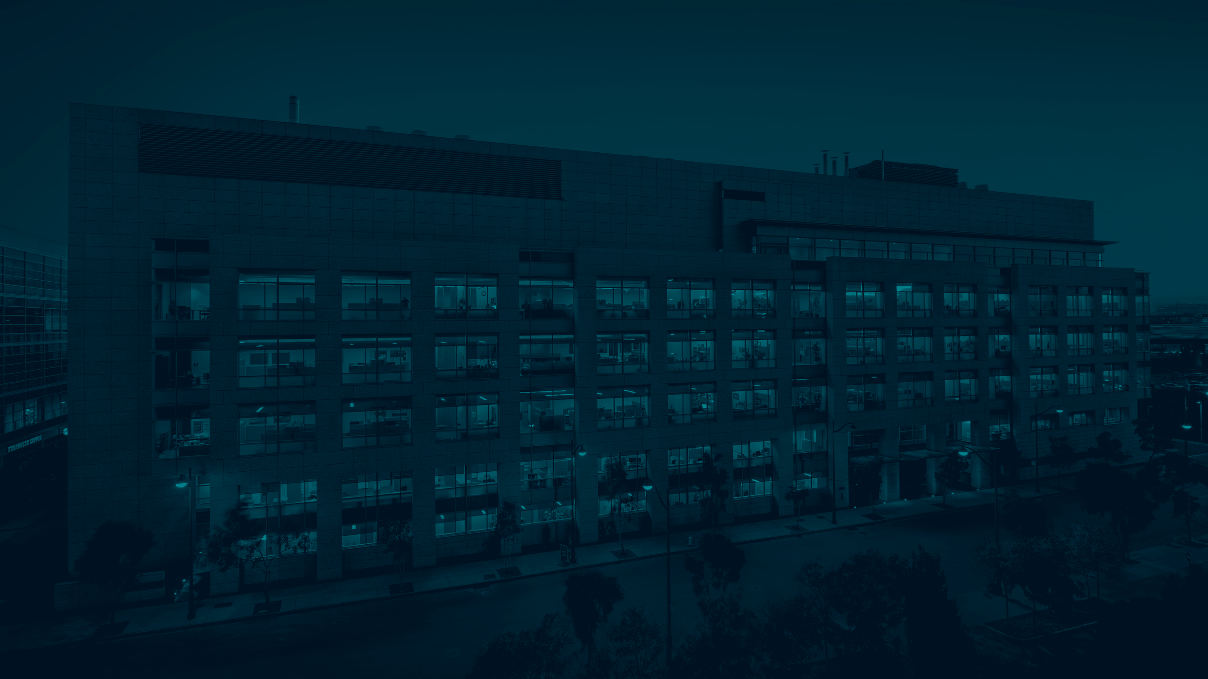
Introductory Machine Learning for Biologists
Table of contents
Introduction
Supervised and Unsupervised
Bias and Variance
Cross Validation
Methods to learn
K-Nearest Neighbors (+ Hands on practice )
K-means clustering (+ Hands on practice )
Decision Tree (+ Hands on practice )
Min-Gyoung Shin
November 1, 2021
2

Slide 3
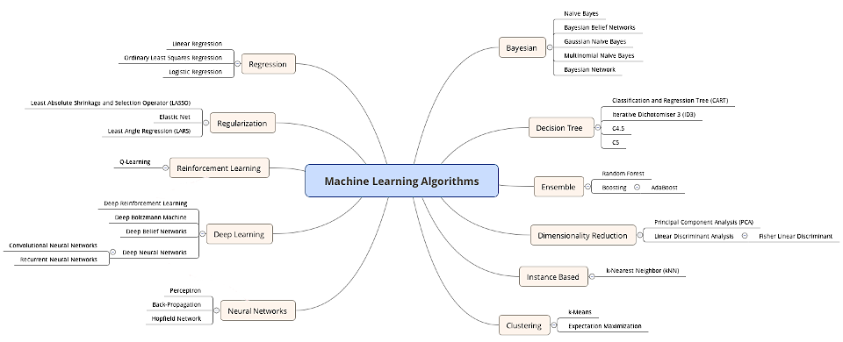
Examples of Machine Learning Methods
Support Vector Machine
https://medium.com/datadriveninvestor

Slide 4
What we are going to learn
K-Nearest Neighbor
K-Means
Decision Tree

Slide 5
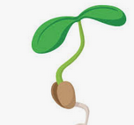


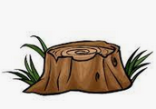
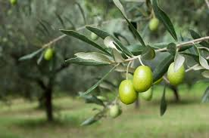
It’s all about prediction!

Slide 6
Example data
Label
Attributes / Features
 | Disease | Heart rate | Respiratory rate | temperature | color | age | Behavior X | weight | …
Mouse 1 | T | 310 | 90 | 37 | grey | 1 | Y | 12
Mouse 2 | F | 400 | 200 | 36.5 | grey | 1 | N | 13
Mouse 3 | T | 430 | 100 | 36.5 | black | 1 | N | 11
Mouse 4 | F | 300 | 190 | 37.2 | grey | 1 | N | 10
Mouse 5 | T | 550 | 221 | 38 | black | 1 | Y | 9
Mouse 6 | F | 700 | 130 | 37.7 | grey | 2 | N | 11.5
…

Slide 7
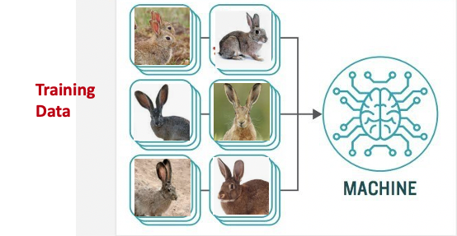
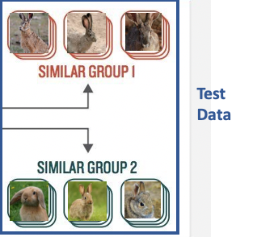
Training Data and Test Data

Slide 8
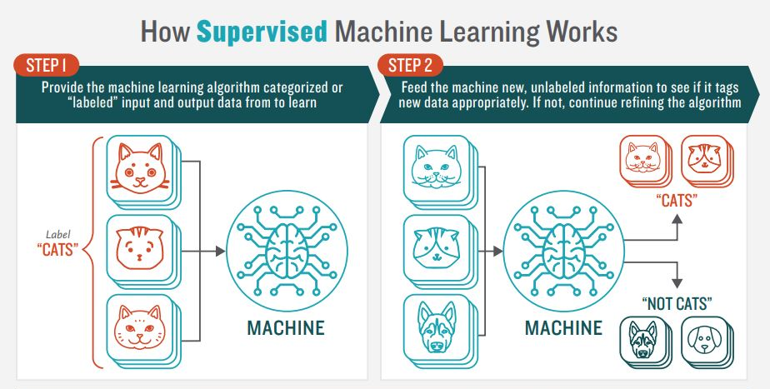
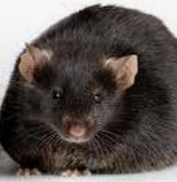
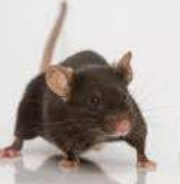
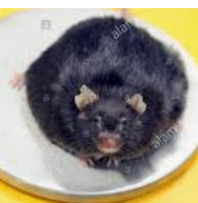
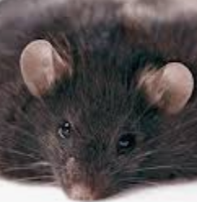
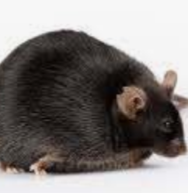
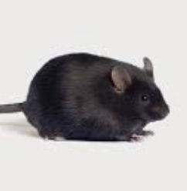
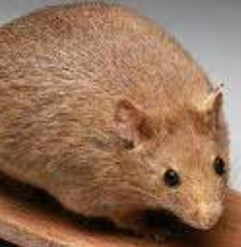
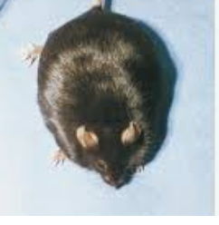
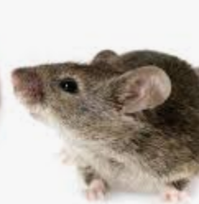
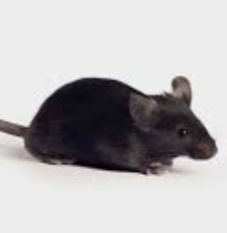
Supervised
Disease
Training
Data
Test
Data
Disease
Healthy
The model requires user input of known values for training
https://www.newtechdojo.com

Slide 9
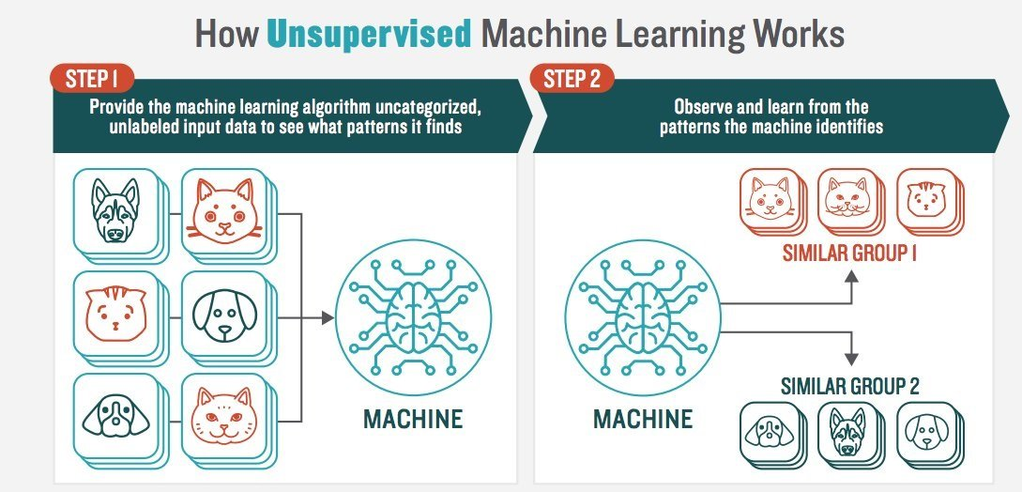
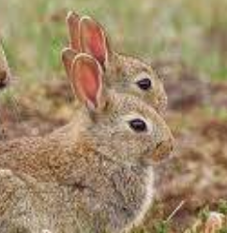
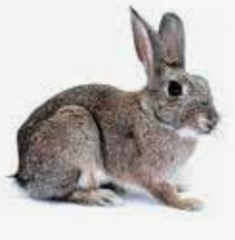
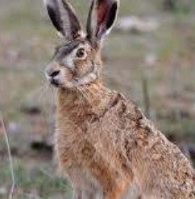
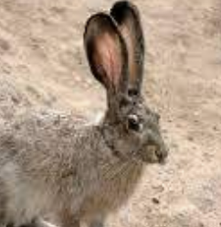
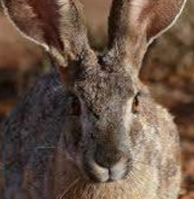
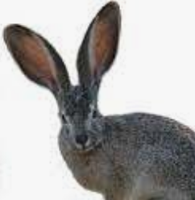
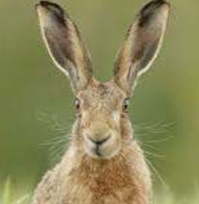

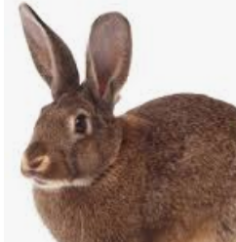
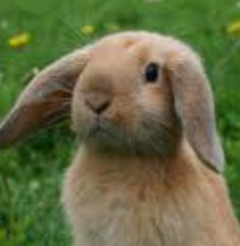
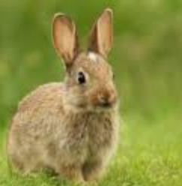
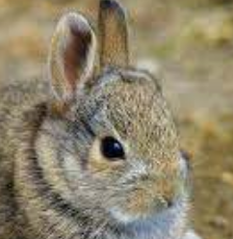
UNSupervised
Training
Data
Test
Data
The models are given unlabeled in order to identify relevant pattern
The machine finds the hidden structure
https://www.newtechdojo.com

Slide 10
https://machine-learning-and-data-science-with-python.readthedocs.io

Slide 11
Classification
Clustering
Regression

Slide 12
Q1. I performed a knockout experiment. I want to cluster genes based on gene expression similarity.
Supervised
Unsupervised

Slide 13
Q1. I performed a knockout experiment. I want to cluster genes based on gene expression similarity.
Supervised
Unsupervised

Slide 14
Q2. I have a cohort with variant information and disease states. I want to make a machine learning model to predict disease states.
Supervised
Unsupervised

Slide 15
Q2. I have a cohort with variant information and disease states. I want to make a machine learning model to predict disease states.
Supervised
Unsupervised

Slide 16
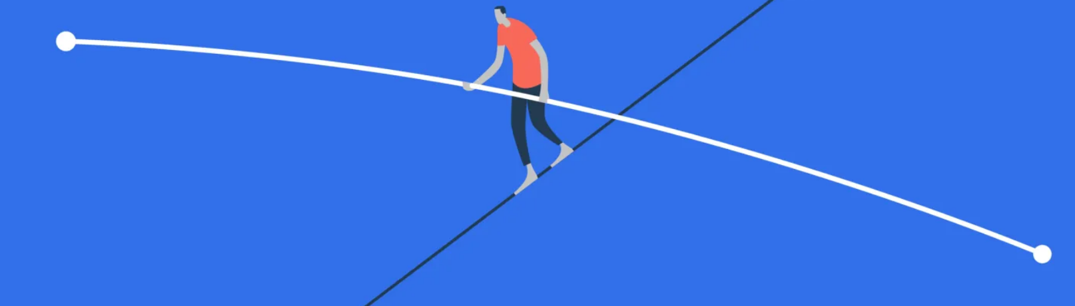
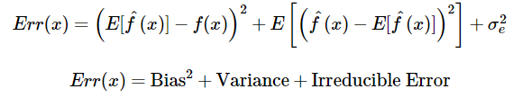
Finding a good prediction model: Balance of Bias and Variance
Bias
Variance

Slide 17
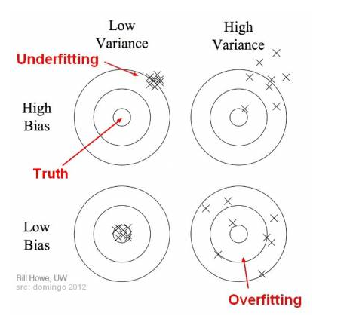
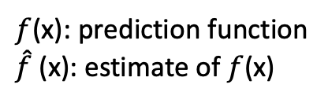
Bias and Variance
$f$(x): prediction function
$\hat{f}$(x): estimate of $f$(x)
https://towardsdatascience.com

Slide 18
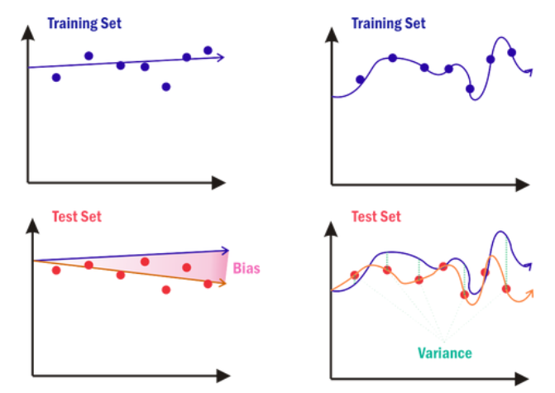
Bias and Variance
High bias
Low variance
https://www.zdnet.com/

Slide 19
Bias and Variance
High bias
Low variance
Low bias
High variance
https://www.zdnet.com/

Slide 20
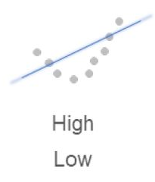
Q3. Predict variance level and bias level

Slide 21
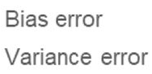
Q3. Predict variance level and bias level

Slide 22
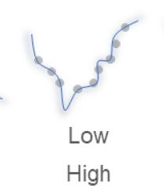
Q4. Predict variance level and bias level

Slide 23
Q4. Predict variance level and bias level

Slide 24
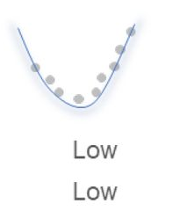
What we want to make:
https://www.biorxiv.org/content/10.1101/2020.12.23.424258v1.full

Slide 25
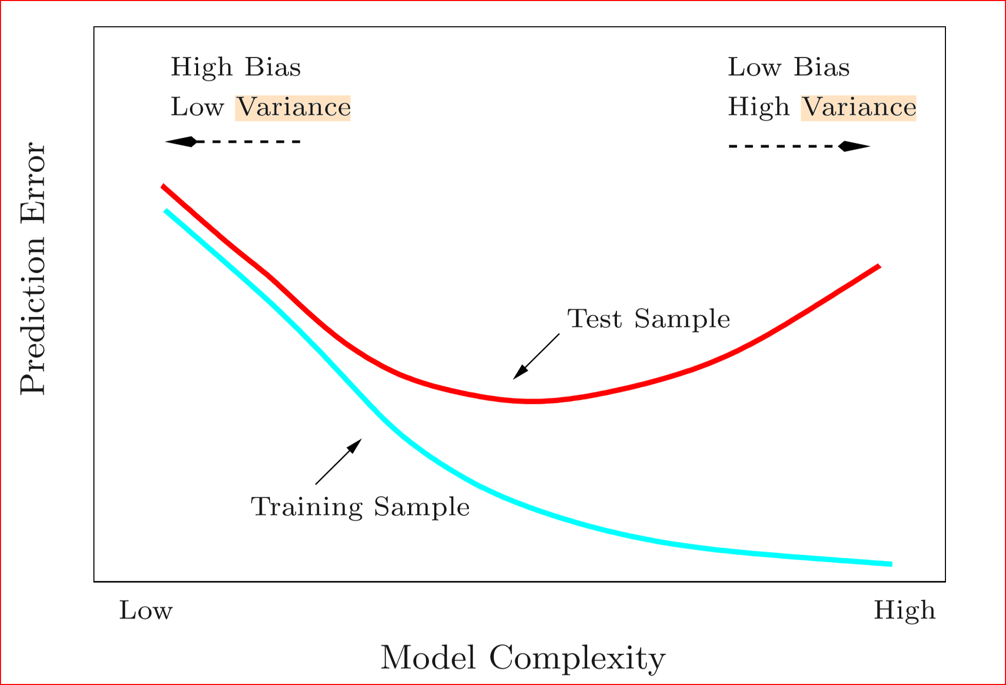
Data
Data
https://medium.com/datadriveninvestor

Slide 26
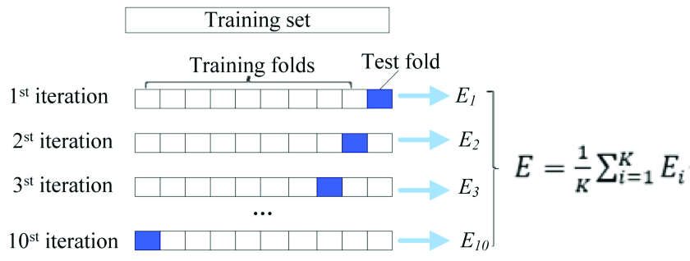
How can we select a model that balances variance & bias?
Use cross-validation!
Bias and variance can be balanced
Niu, Mengting et al. (2018). International journal of molecular sciences.

Slide 27
How can we select a model that balances variance & bias?
Training Data
Use cross-validation!
Bias and variance can be balanced
Test Data
Niu, Mengting et al. (2018). International journal of molecular sciences.

Slide 28
How can we select a model that balances variance & bias?
Training Data
Use cross-validation!
Bias and variance can be balanced
Test Data
Niu, Mengting et al. (2018). International journal of molecular sciences.

Slide 29
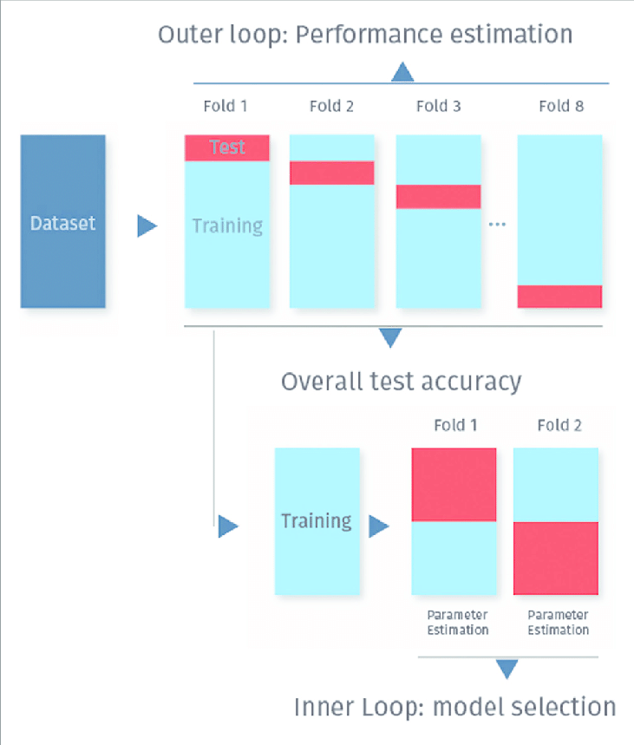
Nested Cross Validation
Kassraian, et al (2016) Frontiers in Psychiatry. 7. 10.3389/fpsyt.2016.00177.

Slide 30
High variance
Overfitting
Good performance only for the training data set
Little generalization
Remedy
Remove attributes from the model
More data

Slide 31
High bias
Underfitting
Overly simple model
Remedy
Try making a more complex model
Add more attributes to the model
Train the model for a longer time

Slide 32
What we are going to learn
K-Nearest Neighbor
K-Means
Decision Tree

Slide 33
K-nearest neighbor (kNN)
Supervised
K: #neighbor data points to consider
Majority vote: collect cluster associations from K (user defined) neighbors and identify the most relevant association

Slide 34
K-nearest neighbor (kNN)
Supervised
K: #neighbor data points to consider
Majority vote: collect cluster associations from k (User defined) neighbors and identify the most relevant association

Slide 35
K-nearest neighbor (kNN)
Supervised
K: #neighbor data points to consider
Majority vote: collect cluster associations from k (User defined) neighbors and identify the most relevant association

Slide 36
K-nearest neighbor (kNN)
Supervised
K: #neighbor data points to consider
Majority vote: collect cluster associations from k (User defined) neighbors and identify the most relevant association

Slide 37
K-nearest neighbor (kNN) steps:
Supervised
Calculate the distance between a new data point and preexisting data points
Sort the results in ascending order
Choose the first K rows
Take the majority vote from the data points within K

Slide 38
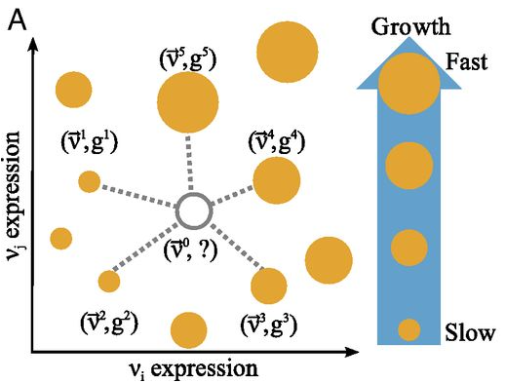
kNN application example
Supervised
Thomas P. Wytock and Adilson E. Motter, PNAS 2019

Slide 39
K-nearest neighbor (kNN)
Supervised
Pros
Easy to implement
Cons
Computationally expensive
Uses a lot of memory
Sensitive to the scale of data and outliers
As the number of dimensions increases, the volume of the input space increases at an exponential rate

Slide 40
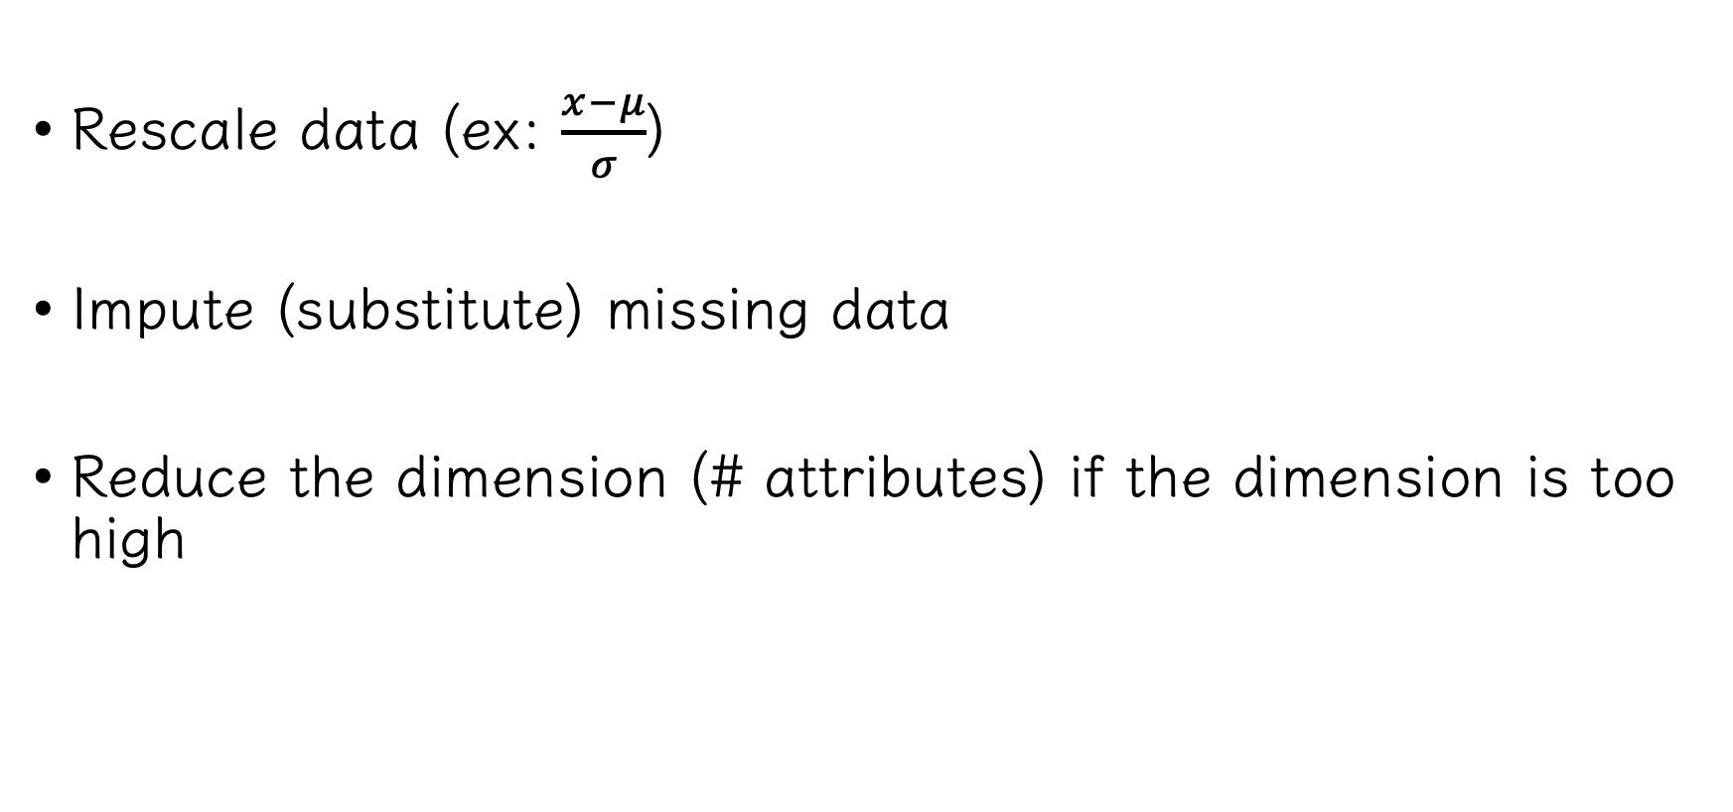
K-nearest neighbor (kNN): Preprocessing
Supervised
Rescale data (ex: $\frac{x−μ}{σ}$)
Impute (substitute) missing data
Reduce the dimension (# attributes) if the dimension is too high

Slide 41
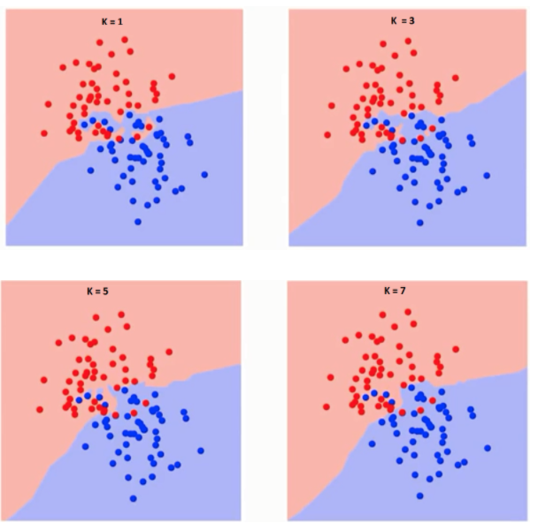
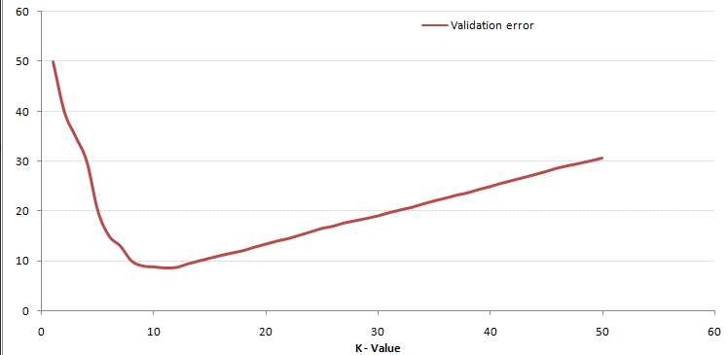
K-nearest neighbor (kNN)
Supervised
K=1
K=3
Test different Ks and find the one with lowest error
K=5
K=7
https://www.analyticsvidhya.com

Slide 42
kNN practice

Slide 43
What we are going to learn
K-Nearest Neighbor
K-Means
Decision Tree

Slide 44
K-means clustering
Unsupervised
Assign a cluster to a data point based on distance from each center (centroid) of each cluster

Slide 45
K-means clustering steps (Lloyd):
Unsupervised
Start: Random centers
Take the sum of the squared distance between data points and all centers
Assign a cluster membership to each data point
Compute new centers
End: if the centers don’t change OR meet iteration threshold

Slide 46
K-means clustering steps (Lloyd):
Unsupervised
Start: Random centers
Take the sum of the squared distance between data points and all centers
Assign a cluster membership to each data point
Compute new centers
End: if the centers don’t change OR meet iteration threshold

Slide 47
K-means clustering steps (Lloyd):
Unsupervised
Start: Random centers
Take the sum of the squared distance between data points and all centers
Assign a cluster membership to each data point
Compute new centers
End: if the centers don’t change OR meet iteration threshold

Slide 48
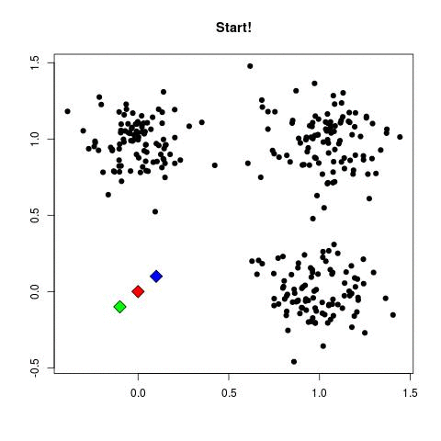
Unsupervised
https://raw.githubusercontent.com/andrewxiechina/DataScience/master/K-Means/k4XcapI.gif

Slide 49
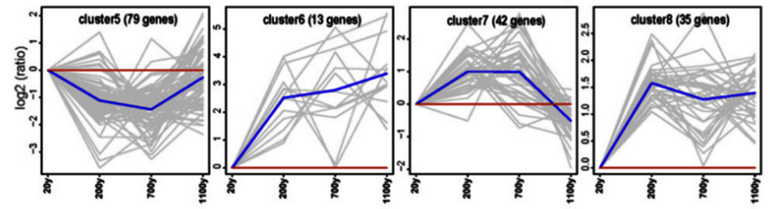
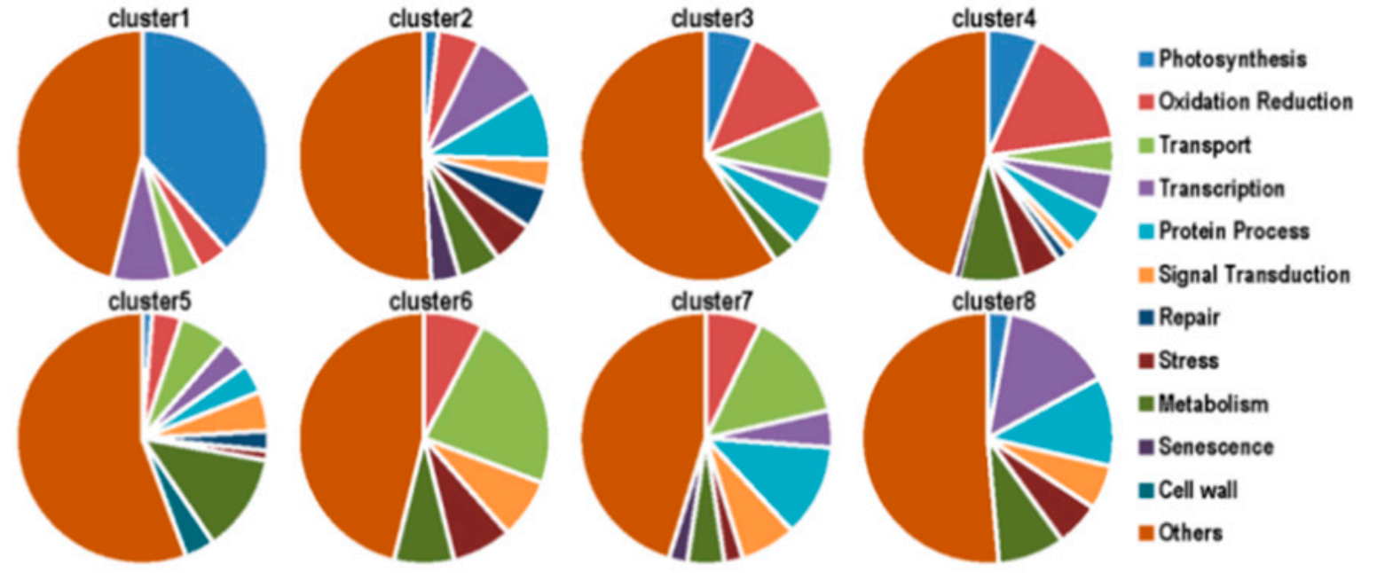
K-means cluster application example
Unsupervised
Chang, Ermei et al,. (2019). Forests 2019, 10(5), 393

Slide 50
K-means clustering
Unsupervised
Pros:
Simple and fast
Cons:
Sensitive to the initial random selection of centers
Sensitive to outliers

Slide 51
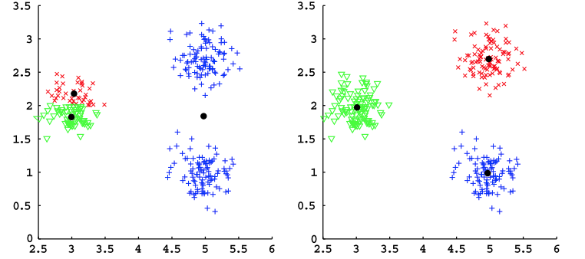
K-means clustering
Unsupervised
Initialization matters!
Grigorios Tzortzis , Pattern Recognition (2014)

Slide 52
K-means clustering, determine k
Unsupervised
Model performance measure (error)

Slide 53

within-cluster sum of squares
$$\sum_{k=1}^{K}{\sum_{i∈S_{k}}{\sum_{j=1}^{P}{{(x_{ij}^{}−{\overline{x}}_{kj}^{})}^{2}}}}$$
where k is the kth cluster, $S_{k}$ is the cluster set of the kth cluster, and j is the jth element of each data point

Slide 54
Survey time & Coffee break
https://www.surveymonkey.com/r/F75J6VZ

Slide 55
K-means practice

Slide 56
What we are going to learn
K-Nearest Neighbor
K-Means
Decision Tree

Slide 57
Decision Tree
Supervised
Node: attributes
Leaf node: label
Edge: connection between
nodes
Root node
Internal
node
Internal
node
Leaf node
Leaf node
Leaf node
Leaf node

Slide 58
Root rule0
Rule A
Rule B
Disease
Healthy
Disease
Healthy

Slide 59



Decision Tree: which feature to use?
Supervised
Evaluation
$$Gini Index:1− \sum_{i=1}^{m}{{P_{i}}^{2}}$$
$Information Gain$: Entropy(before split) – Entropy(after split)
Entropy: -$\sum_{i=1}^{m}{p_{i}\log_{2}⁡(p_{i})}$

Slide 60
Decision Tree: which feature to use?
Supervised
Gini index: High
Information Gain: Low
Gini index: Low
Information Gain: High

Slide 61
Decision Tree: which feature to use?
Supervised
Gender
Total: 11
Case: 5
Age
F
Total: 5
Case: 2
M
Total: 6
Case: 3
40 >
Total: 5
Case: 1
40 <=
Total: 6
Case: 4
Gini index: 1- (2/5)^2 – (3/5)^2 1- (3/6)^2 – (3/6)^2
1- (1/5)^2 – (4/5)^2 1- (4/6)^2 – (2/6)^2
Weighted sum: 0.49
Weighted sum: 0.39

Slide 62

Decision Tree: which feature to use?
Supervised
Gender
Total: 11
Case: 5
Age
F
Total: 5
Case: 2
M
Total: 6
Case: 3
40 >
Total: 5
Case: 1
40 <=
Total: 6
Case: 4
Gini index: 1- (2/5)^2 – (3/5)^2 1- (3/6)^2 – (3/6)^2
1- (1/5)^2 – (4/5)^2 1- (4/6)^2 – (2/6)^2
Weighted sum: 0.49
Weighted sum: 0.39

Slide 63

Decision Tree application example
Supervised
Yokoyama, J.S., Bonham, L.W., Sears, R.L. et al. BMC Neurol 15, 47 (2015)

Slide 64
Decision Tree
Supervised
Pros
Easy interpretation
Not influenced by outliers and missing values
Cons
Higher computational time for training and to process data
Not global optimal solution
Overfitting => pruning
Selection bias toward attributes with many possible splits
(Use Gain Ratio)

Slide 65
Complexity parameter (cp)
Governs the minimum “benefit” that must be gained at each split of the decision tree in order to make a split worthwhile.
Williams G. (2011) Decision Trees. In: Data Mining with Rattle and R. Use R. Springer, New York, NY
Trims off least important splits at each run.
Penalizes models that are too complex.
Muhammad Azam et al. (2017) Simulation and Computation, 46:4, 2924-2934

Slide 66
Decision Tree practice

Slide 67
More advanced methods
Support Vector Machine
Random Forest
Neural Network

Slide 68
Thank you!

